Slide 1
D-SYNC presents DragonAttack

Slide 2
Who are we?
Game Designer
Andrew Chong
Technical Lead
Javon Lee
Producer
Jacob Lim
Product Manager
William Yoong

Slide 3
THE GAME

Slide 4
Job Allocations

Slide 5
Level Design

Slide 7
Collision
&
UI

Slide 8
AI

Slide 9
AI
Basic AI
Mage
Grunt
Archer
Knight
Boss AI
Lancelot
Merlin
King Arthur

Slide 10

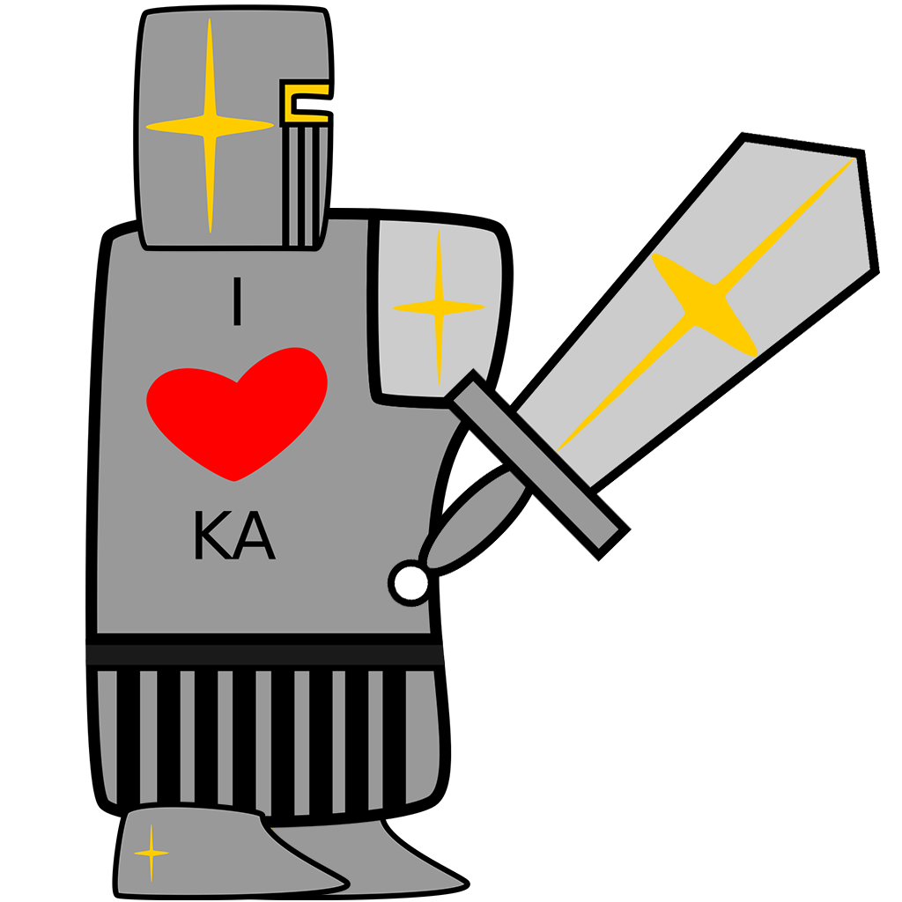


Basic AIs

Slide 11
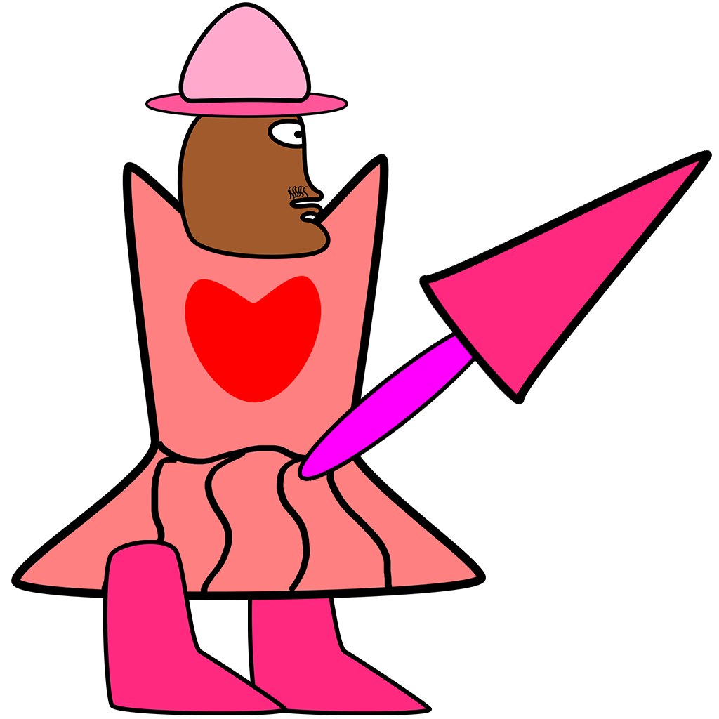
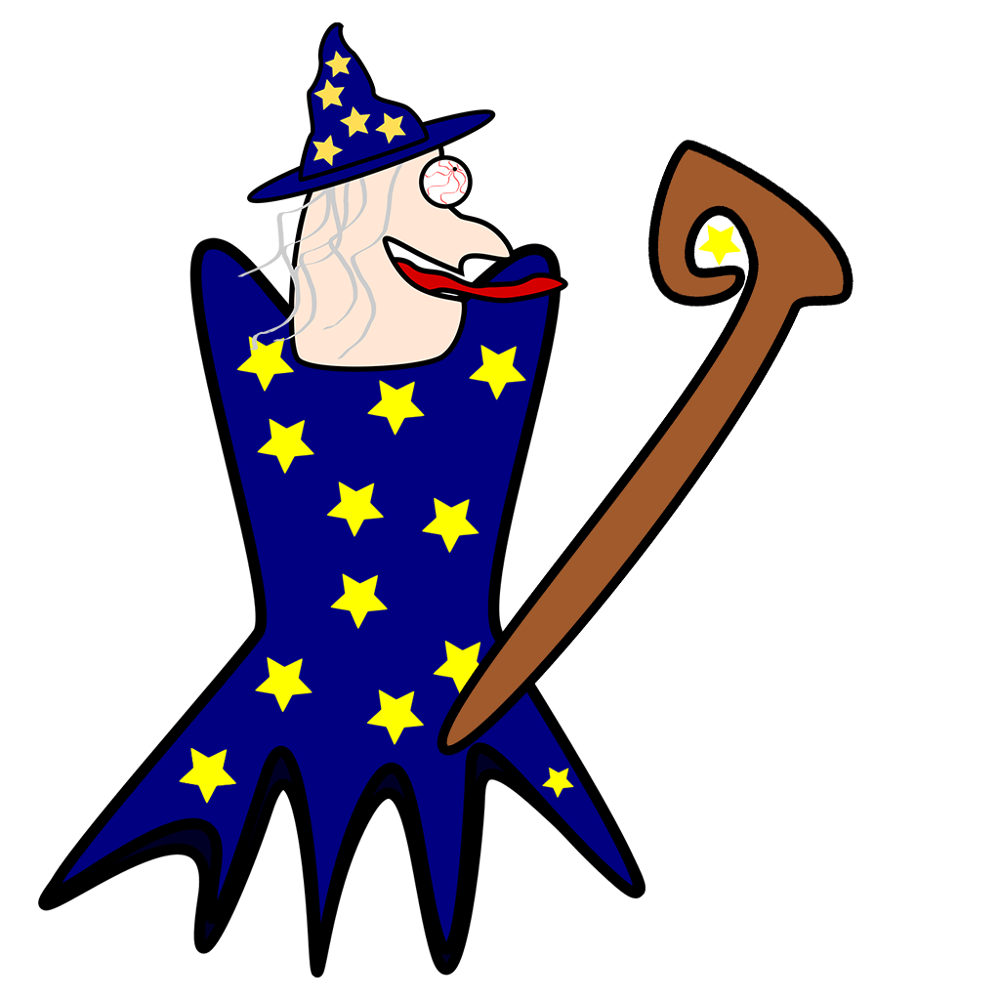
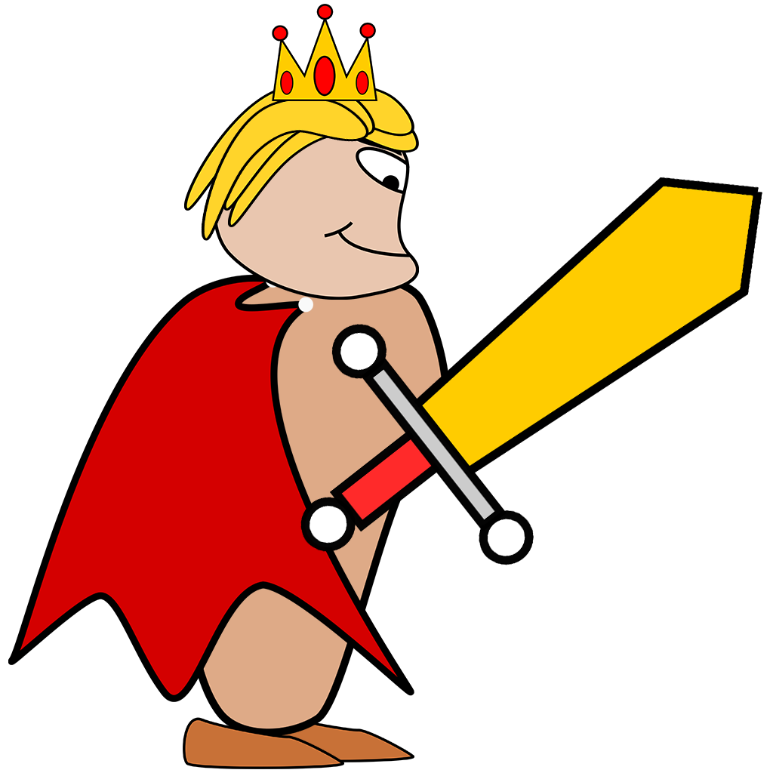
Boss AIs

Slide 12
Graphics & Utilities

Slide 14
AND TABLES TO COMPARE DATA
 | A | B | C
Yellow | 10 | 20 | 7
Blue | 30 | 15 | 10
Orange | 5 | 24 | 16

Slide 15
89,526,124$
185,244 users
100%
That’s a lot of money
And a lot of users
Total success!

Slide 16
OUR PROCESS IS EASY
1.
first
2.
second
3.
third

Slide 17
Let’s review some concepts
Yellow
Is the color of gold, butter and ripe lemons. In the spectrum of visible light, yellow is found between green and orange.
Blue
Is the colour of the clear sky and the deep sea. It is located between violet and green on the optical spectrum.
Red
Is the color of blood, and because of this it has historically been associated with sacrifice, danger and courage.
Yellow
Is the color of gold, butter and ripe lemons. In the spectrum of visible light, yellow is found between green and orange.
Blue
Is the colour of the clear sky and the deep sea. It is located between violet and green on the optical spectrum.
Red
Is the color of blood, and because of this it has historically been associated with sacrifice, danger and courage.

Slide 18
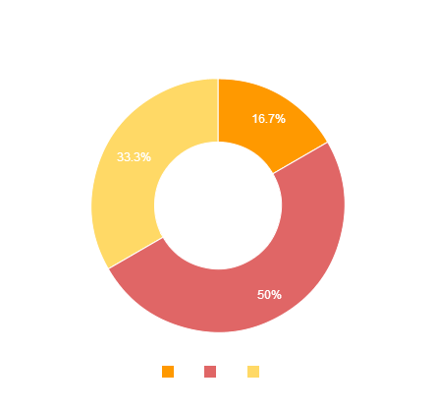
You can copy&paste graphs from Google Sheets

Slide 19
Place your screenshot here
ANDROID PROJECT
Show and explain your web, app or software projects using these gadget templates.

Slide 20
IPHONE PROJECT
Show and explain your web, app or software projects using these gadget templates.
Place your screenshot here

Slide 21
TABLET PROJECT
Show and explain your web, app or software projects using these gadget templates.
Place your screenshot here

Slide 22
Place your screenshot here
DESKTOP PROJECT
Show and explain your web, app or software projects using these gadget templates.

Slide 23
THANKS!
Any questions?

Slide 24
CREDITS
Special thanks to all the people who made and released these awesome resources for free:
Presentation template by SlidesCarnival
Photographs by Unsplash

Slide 25
😉
Now you can use any emoji as an icon!
And of course it resizes without losing quality and you can change the color.
How? Follow Google instructions https://twitter.com/googledocs/status/730087240156643328
✋👆👉👍👤👦👧👨👩👪💃🏃💑❤😂😉😋😒😭👶😸🐟🍒🍔💣📌📖🔨🎃🎈🎨🏈🏰🌏🔌🔑 and many more...

